Slide 1
Lecture 3: Atoms & periodic table
California State University, Fullerton
2023 Fall Semester – Chem 123

Slide 2

QUESTIONS, COMMENTS, AND CONCERNS?

Slide 3
Outline
Waitlist
Ch. 1: Science and Measurements
Dimensional Analysis – Density and Temperature
Ch. 2: Atoms & Periodic Table
Law of Conservation of Mass
History of the Atom – Subatomic particles
Periodic Table – Chem. symbols

Slide 4
waitlist
Dropped two students from the course
Class has a capacity of 80 students; there were 83 students enrolled at one point
Discussing with Biochemistry & Chemistry Department

Slide 5
Outline
Waitlist
Ch. 1: Science and Measurements
Dimensional Analysis – Density and Temperature
Ch. 2: Atoms & Periodic Table
Law of Conservation of Mass
History of the Atom – Subatomic particles
Periodic Table – Chem. Symbols, atomic mass, isotopes, and ions

Slide 6
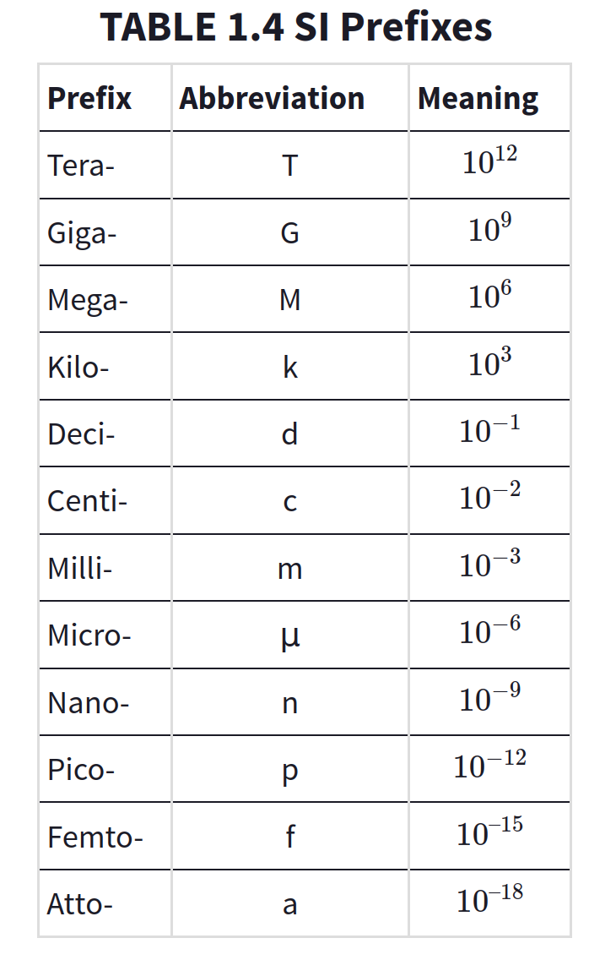
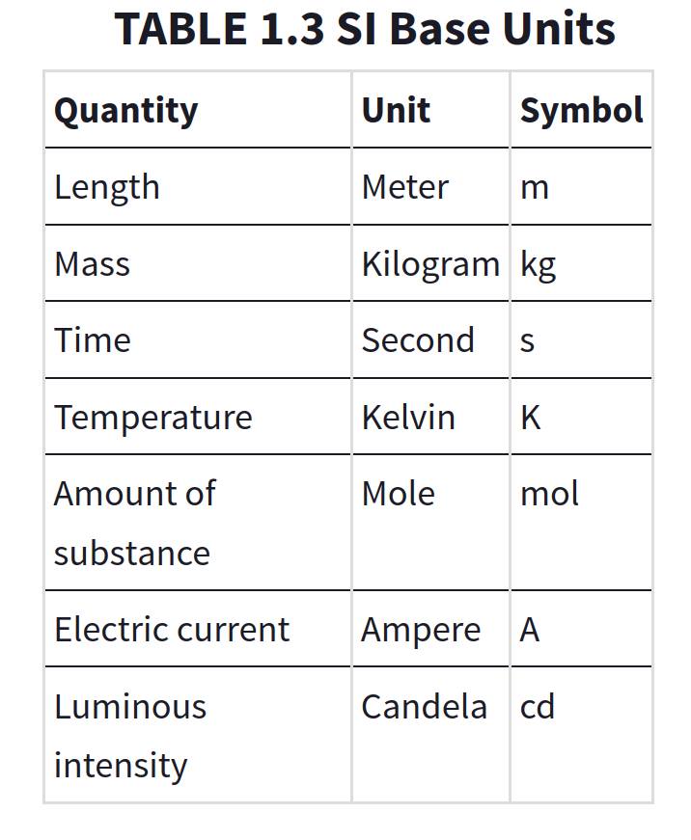
SI Base Units and Prefixes

Slide 7
SI Base Units and Prefixes
Unit for length (meters – m)
1 Gm = 1,000,000,000 m
1 Mm = 1,000,000 m
1 km = 1,000 m 1 m = 10 dm
1 m = 100 cm
1 m = 1,000 mm

Slide 8
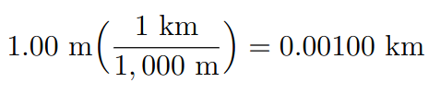
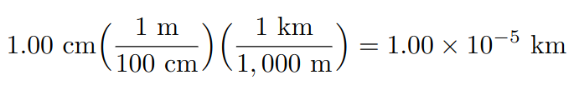
Dimensional analysis
Approach: Unit conversion is a ratio. Think about what units should be in the denominator and the numerator
Example:

Slide 9
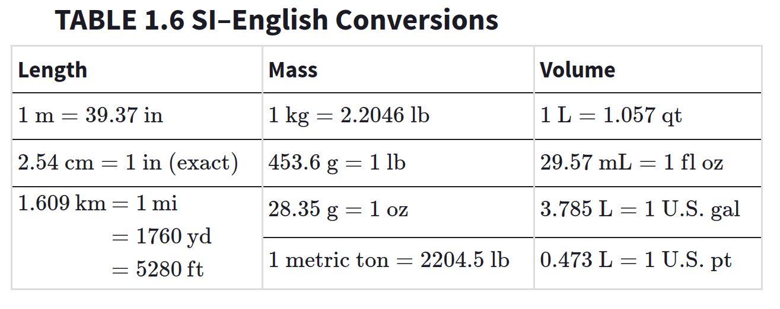
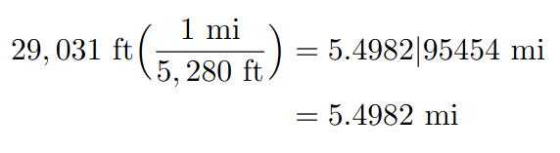
Dimensional analysis
Example: Mount Everest is 29,031 ft high. Convert this to miles.

Slide 10
Density
Density – Measure of mass occupying space (g/mL)
Density = mass/volume
Temperature – Average kinetic energy of the atoms and molecule (°C, °F, or K)
T_{C} = (5/9)(T_{F} – 32)
T_{K} = T_{C} + 273.15

Slide 11
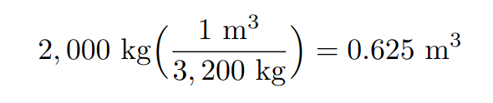
Density Problems
Example: Rocks are sometimes used along coasts to prevent erosion. If a rock needs to weigh 2,000 kilograms (about 2 tons) in order not to be shifted by waves, what volume does it need to be? The rock is made of basalt, which has a typical density of 3,200 kg/m³

Slide 12
Outline
Waitlist
Ch. 1: Science and Measurements
Dimensional Analysis – Density and Temperature
Ch. 2: Atoms & Periodic Table
Law of Conservation of Mass
History of the Atom – Subatomic particles
Periodic Table – Chem. Symbols, atomic mass, isotopes, and ions

Slide 13
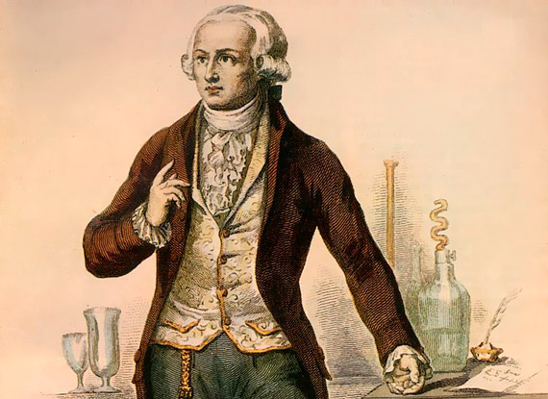
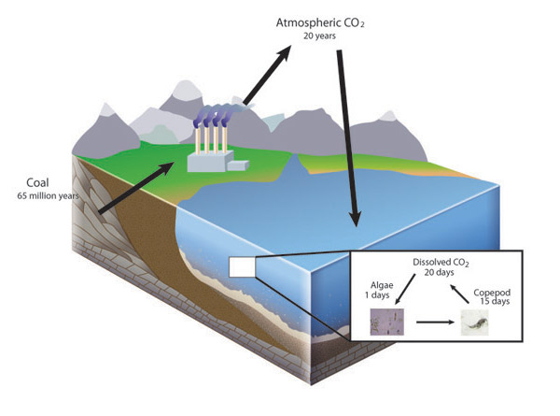
Law of conservation of mass
"Matter is neither created nor destroyed." - Antoine Lavoisier

Slide 14
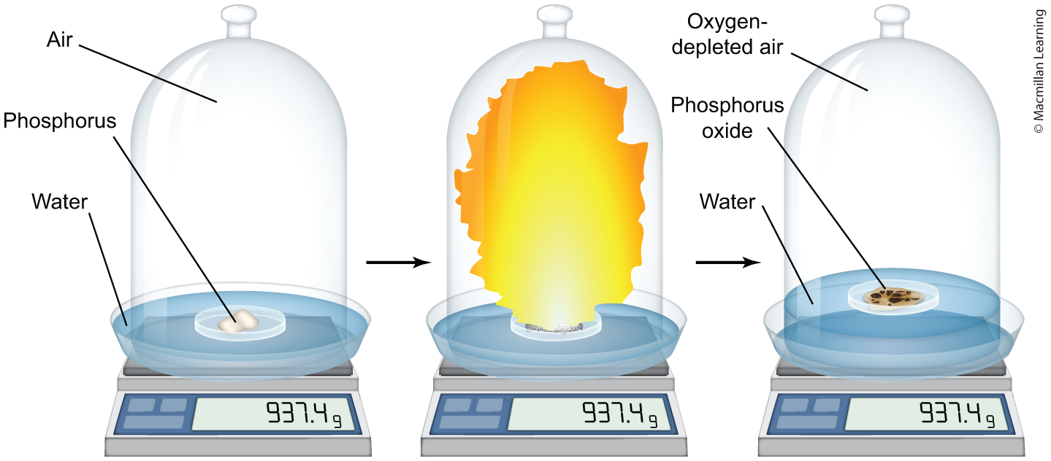
Law of conservation of mass
Sealed container: Mass remains constant

Slide 15
Dalton's atomic theory
Elements consist of indivisible small particles (atoms).
All atoms of the same element are identical; different elements have different types of atom.
Atoms can neither be created nor destroyed.
'Compound elements’ (i.e. compounds) are formed when atoms of different elements join in simple ratios to form ‘compound atoms’ (i.e. molecules).
Note: Part 2 had to be revised due to mass spectrometry experiment showing the existence of isotopes (different atomic masses)

Slide 16
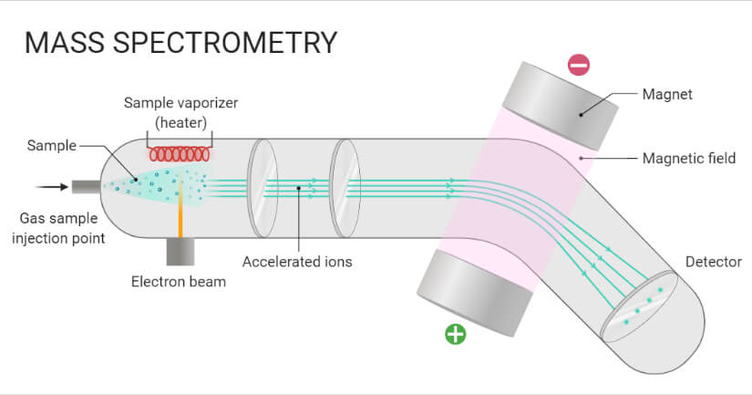
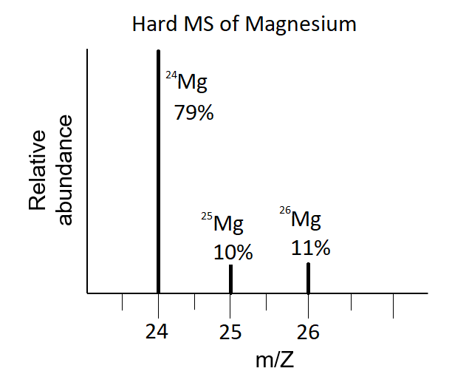
Mass Spectrometry and isotopes
Note: Part 2 had to be revised due to mass spectrometry experiment showing the existence of isotopes

Slide 17
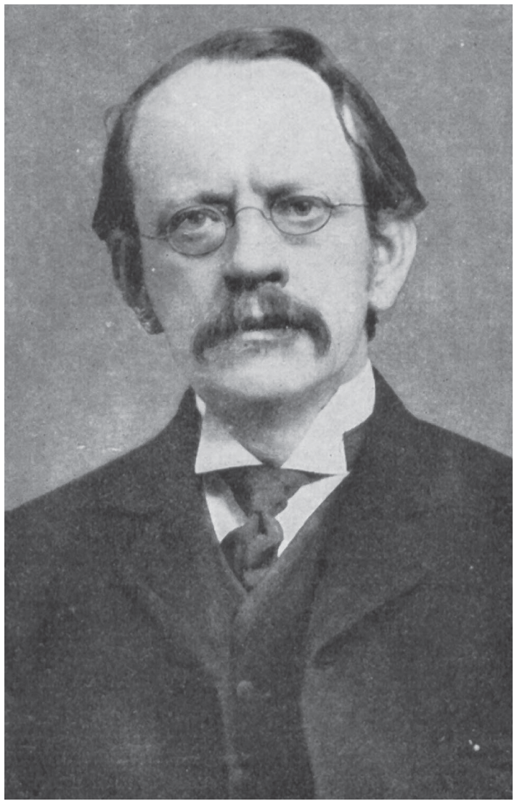
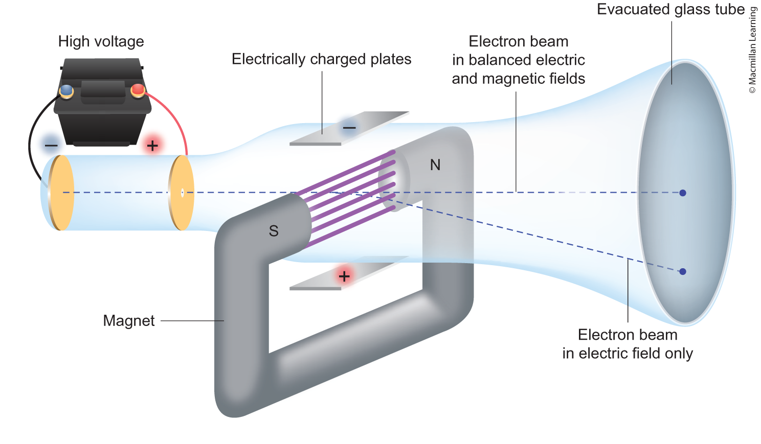
Existence of the electron
J.J. Thompson performed cathode ray experiment and noticed the beam to deflect

Slide 18
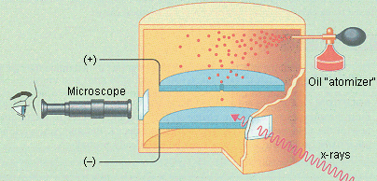
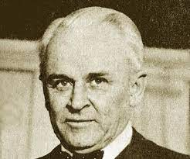
Charge of electron
Robert Millikan performed oil drop experiment determining the charge and mass of the electron (-1.60 x 10⁻¹⁹ C and 9.109 x 10⁻³¹ g)

Slide 19
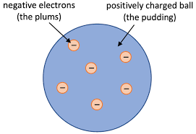
Plum pudding model
Based on the observations: JJ Thompson proposed the plum pudding model

Slide 20





Test: Plum pudding model
Ernest Rutherford: tested the plum pudding model

Slide 21
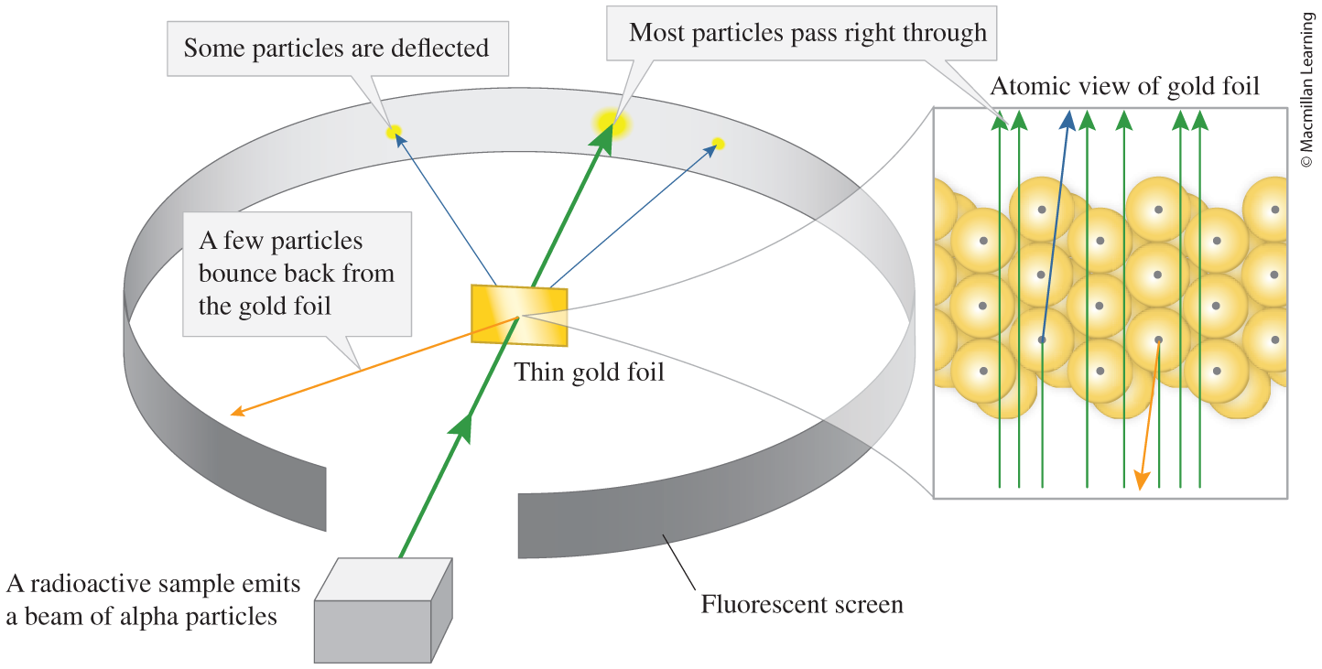
Test: Plum pudding model
Ernest Rutherford Gold Foil experiment:

Slide 22
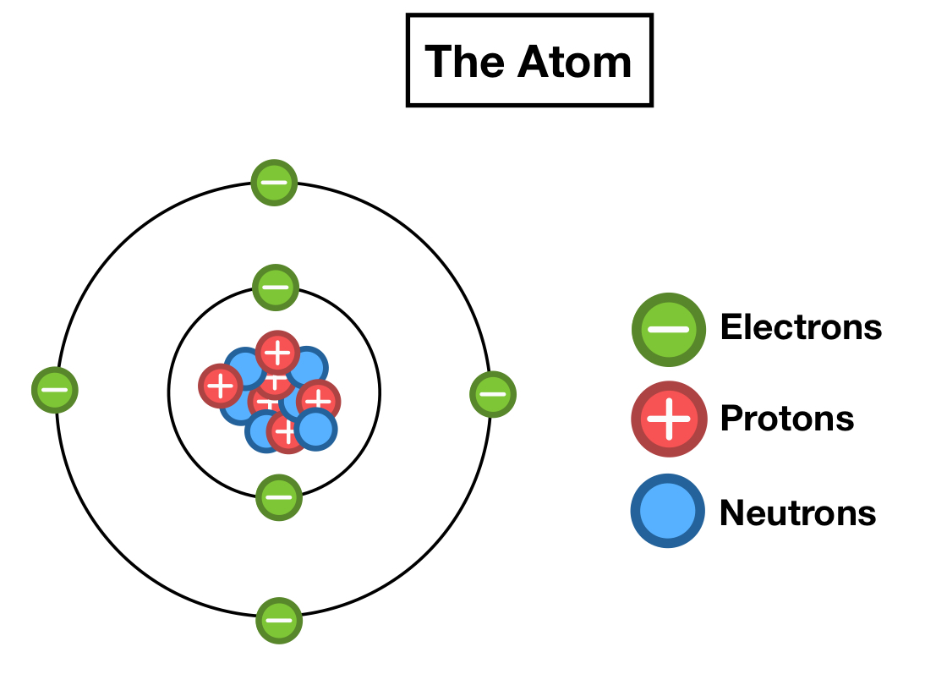
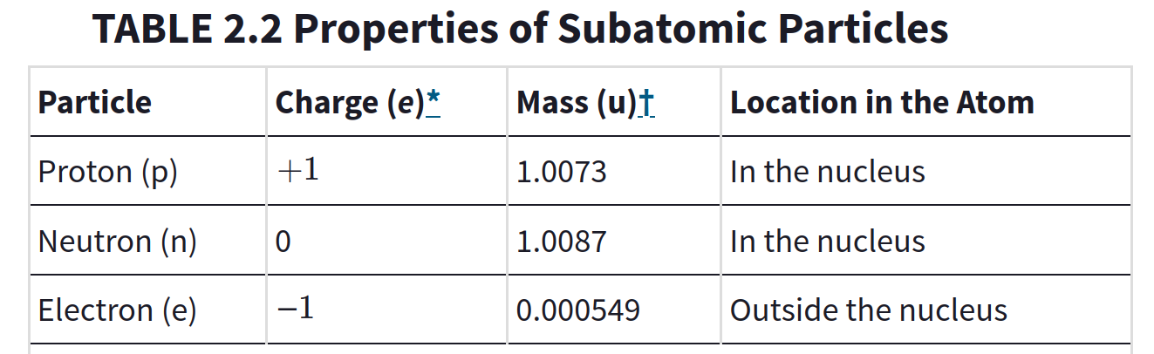
Modern nuclear model of the atom
The atom's positive charge is localized at the center known as the nucleus
Majority of the atom is empty space
Number of negatively charged electrons equals the number of positively charged protons
Q: If atoms are mostly empty space, aren't we full of empty space?

Slide 23
Modern nuclear model of the atom
Q: True or False. The total mass of an atom is the sum of the mass of protons and neutrons.

Slide 24
Outline
Waitlist
Ch. 1: Science and Measurements
Dimensional Analysis – Density and Temperature
Ch. 2: Atoms & Periodic Table
Law of Conservation of Mass
History of the Atom – Subatomic particles
Periodic Table – Chem. Symbols, atomic mass, isotopes, and ions

Slide 25
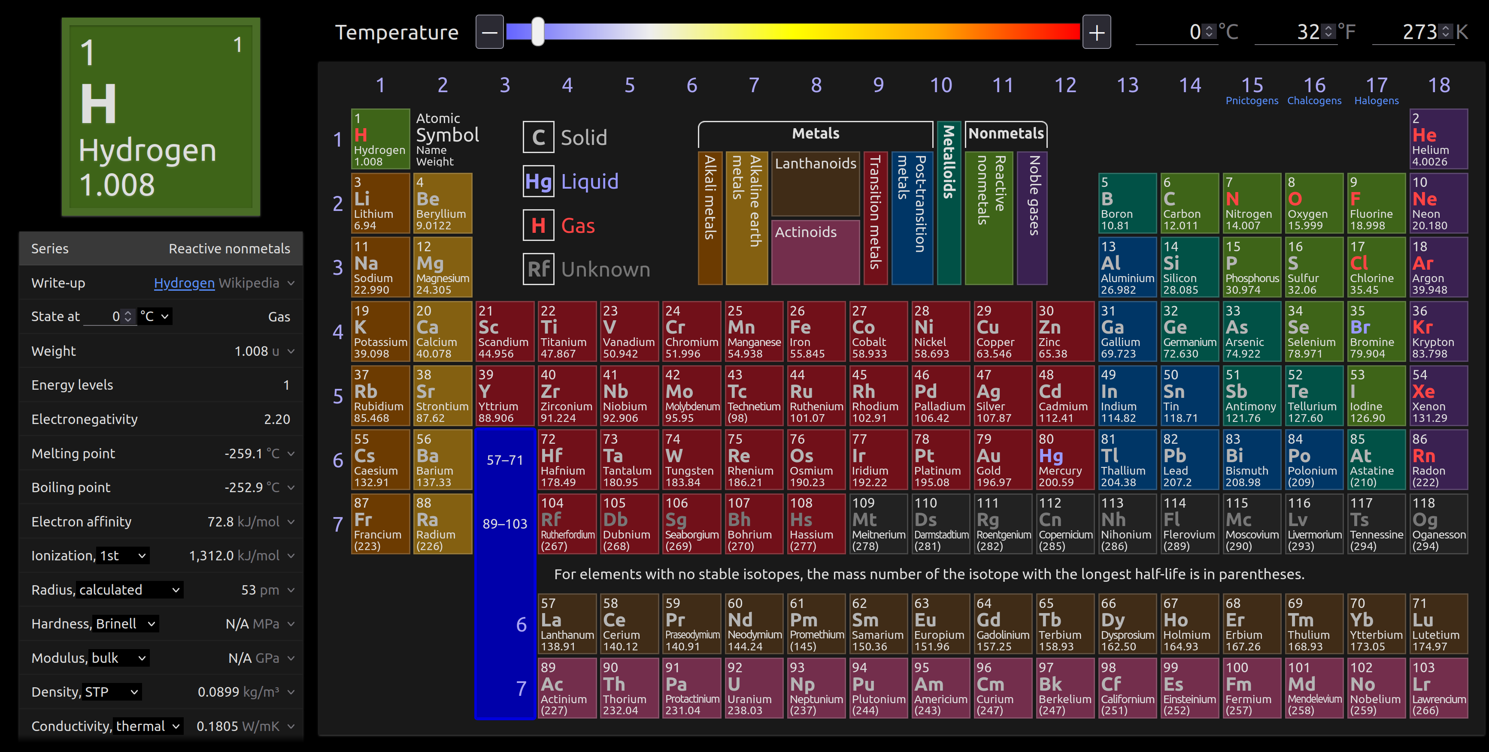
Periodic Table – Use ptable.com

Slide 26


Periodic Table – Use ptable.com
Z – atomic number (number of protons)
A – atomic mass (sum of protons and neutrons)

Slide 27
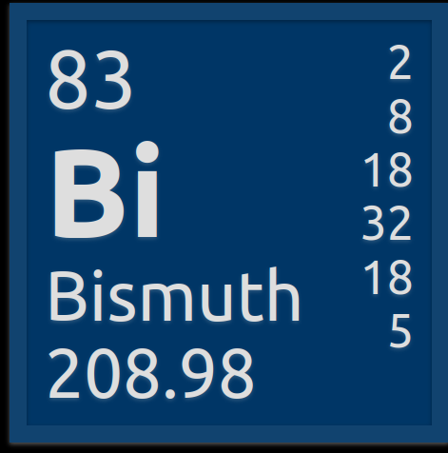
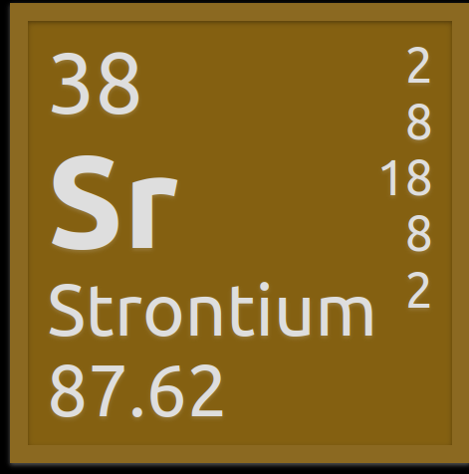
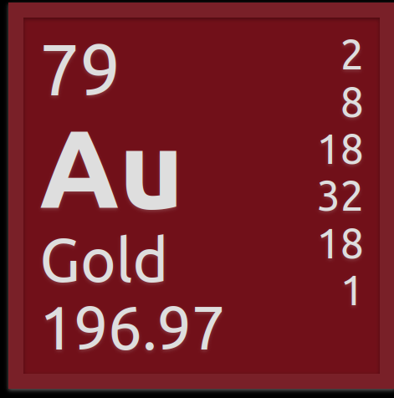


Your Turn: Periodic table
Determine the atomic number and mass of the elements above. In addition, how many electrons, protons, and neutrons?

Slide 28
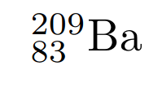
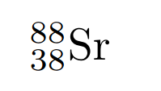
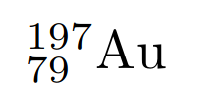
Periodic table: Chemical symbol

Slide 29
Periodic Table – ordered based on atomic number

Slide 30
Periodic Table – types of electrons
Core electrons: electrons closest to the nucleus and does not participate in reactions
Valence electrons: electrons furthest away from the nucleus and determines the physical and chemical properties of atoms

Slide 31
Periodic Table – isotopes and atomic masses
Isotope: Same number of protons and different number of neutrons; hence, different atomic masses
Atomic masses on periodic table are the weighted average of all naturally occurring elements
Weighted average = I₁A₁ + I₂A₂ + I₃A₃ + ...
I = isotope atomic mass
A = relative abundance between 0 and 1; A₁ + A₂ + A₃ + ... = 1
Subscripts 1, 2, 3, ... are isotope 1, 2, 3, etc.

Slide 32
Periodic Table – isotopes and atomic masses
Example: Naturally occurring lithium consists of two stable isotopes: 7.59% ⁶Li with an atomic mass of 6.015 au, and 92.41% ⁷Li with an atomic mass of 7.016 au. Calculate the atomic mass of lithium.
Weighted average Li = I₁A₁ + I₂A₂
= (7.59%/100%)(6.015 au) + (92.41%/100%)(7.016 au)
= 6.94 au

Slide 33
Periodic Table – isotopes and atomic masses
Your Turn: There are two most abundant chlorine isotopes (³⁵Cl and ³⁷Cl). 75.76% ³⁵Cl with an atomic mass of 34.9689 au. Given the atomic mass of chlorine is 35.453 au, calculate the isotope mass and relative abundance of ³⁷Cl.
Hints: Weighted average Cl = I₁A₁ + I₂A₂ and A₁ + A₂ = 1

